Slide 1
Lesson #2
Objects and prepositions
Sentence formation

Slide 2
Practice talking with last week’s lesson
Pratique conversando com a lição da semana passada

Slide 3
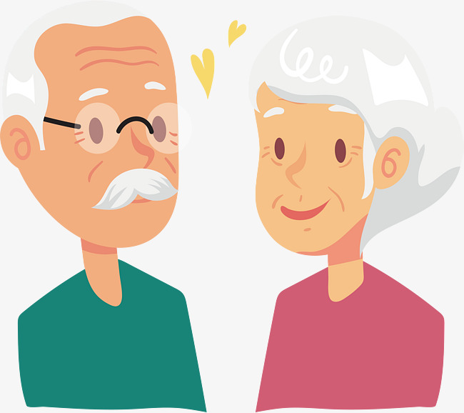
More family members
Brother and sister = irmão e irmã
Together → The siblings
Grandfather and grandmother = avô e avó
Together → The grandparents
Husband and Wife = Esposos
(Man) (Woman)
Together → They are married
Grandchild = neto, neta
Uncle and aunt = tio e tia
Cousin = primo, prima
Notes:
juntos

Slide 4
Talk about the family … Verbs
To live (with) = morar (com)
I live with my husband.
To have a sibling = ter um irmão/uma irmã
Do you have a sibling? → Yes! I have a ______
To be _____ years old = ter ____ anos
How old are you? → I am ___ years old, He/she is ____ years old.
To like = gostar … I like to work.
To love = amar

Slide 5
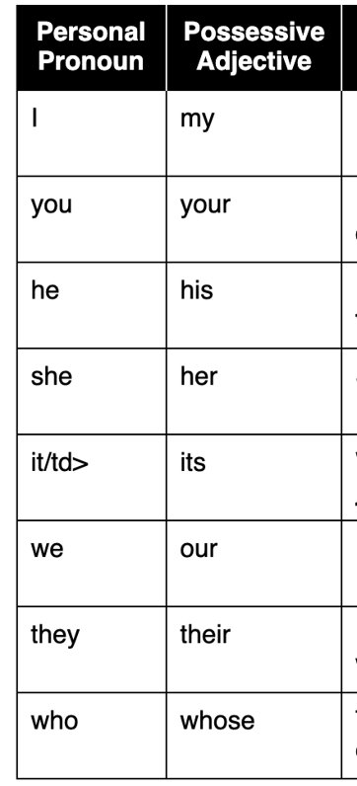
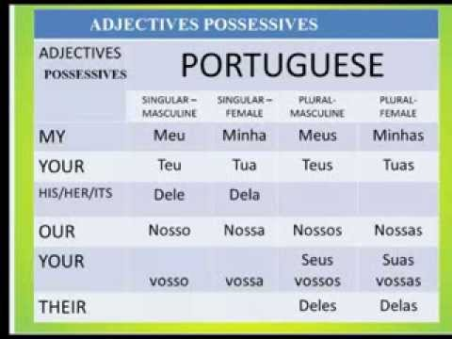
POSSESSIVE ADJECTIVES
My apple.
Your soccer ball.
Our house.
Your name.
Their friend.

Slide 6
Possessives with family
My + family member
Your + family member (SINGULAR)
His + family member (MALE)
Her + family member (FEMALE)
Its + family member (ANIMAL)
Our + family member (GROUP)
Your + family member (PLURAL inclusive)
Their + family member
My
Your
His, Her, Its
Our
Your
Their

Slide 7
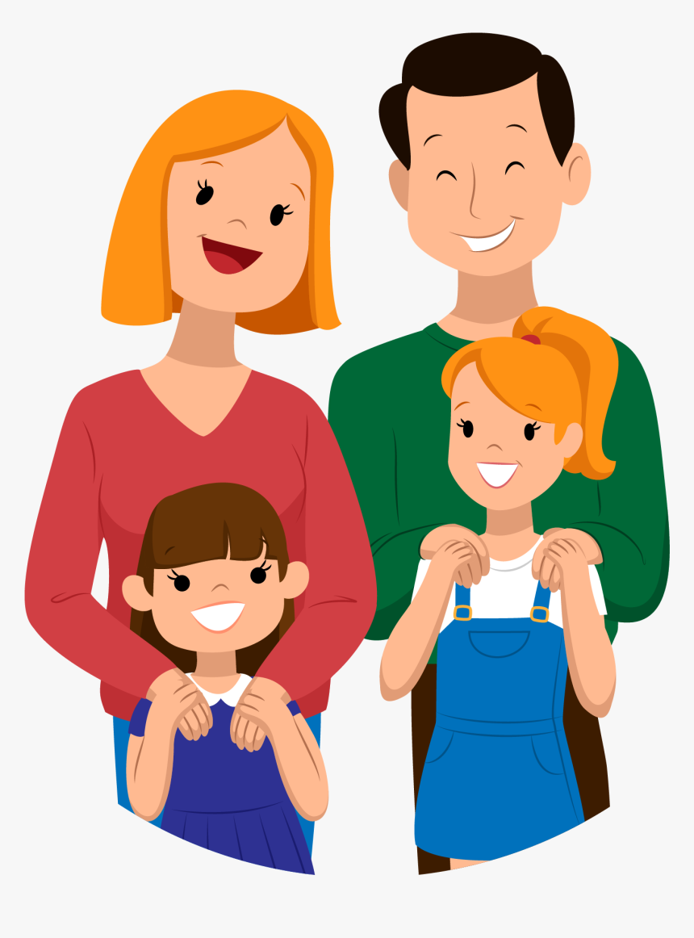
Questions about the family
Who do you live with?
I live with my mother and father and my brother.
Do you have siblings?
Yes, I have one brother. / No, I do not have siblings.
How old is your brother?
He is 15 (fifteen) years old.
What does your daughter like?
She likes to read. Read = ler
She loves to swim. Swim = nadar

Slide 8
Talk about the family … Hobbies
To read = ler
To walk = caminhar
To run = correr
To play soccer = jogar futebol
To cook = cozinhar
To watch TV = assistir TV
To swim = nadar
To spend time with family =
passar tempo com a família
To travel = viajar
To paint = pintar
“What do you like to do?” or “What are your hobbies?” → I like to _____.
Notes:
“Hobbies” are activities to in your free time.
atividades para fazer no seu tempo livre

Slide 9
Objects review

Slide 10
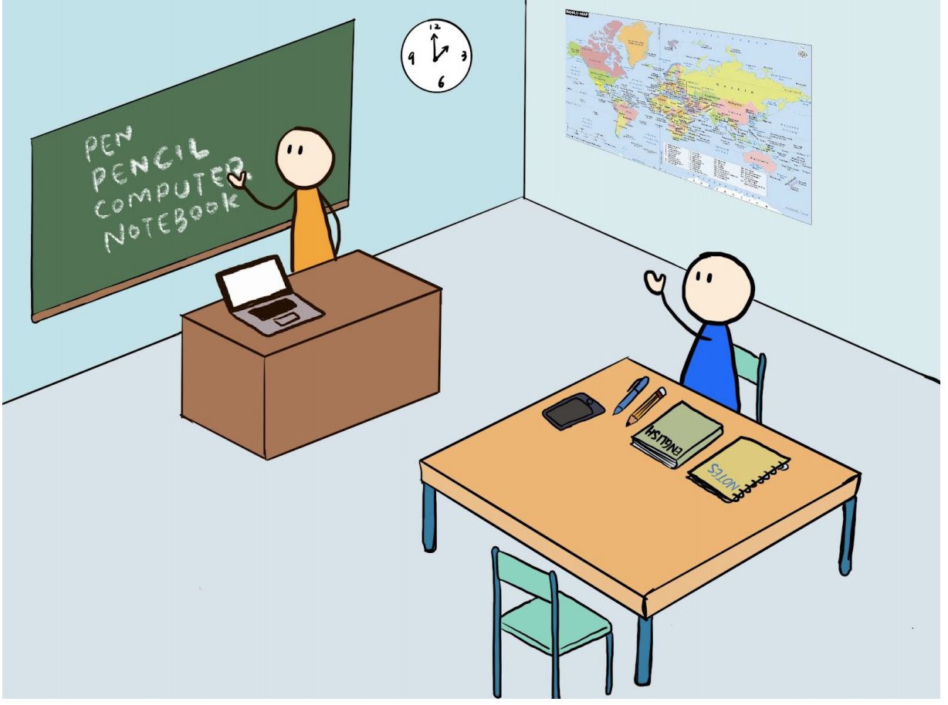
OBJECTS
What is it?
It is a ___
clock, pen, desk, chair, book, pencil, notebook, wall, computer, phone
Where is it?
On, In, Under, above, next to

Slide 11
Vocabulary: objects at home
Examples:
I read a book.
We sit at the table.
The student works at his desk.
You need pens and pencils for school.
Book = livro
Table = mesa
Chair = cadeira
Desk = escrivaninha
Pencil = lápis
Pen = caneta
Paper = papel
Computer = computador
Notes:
Many = muitos

Slide 12
Prepositions

Slide 13
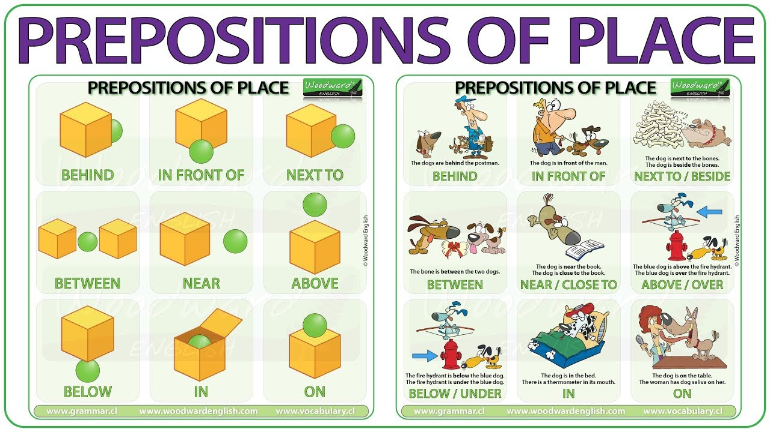

Slide 14
Sentence formation

Slide 15

Expressions
A lot
Many
A little
Few
Some
This
That
These
Those

Slide 16
Practice with “To be”
I _____ a woman.
You “are” a tall man.
It “is” a nice day outside! He, she, it IS
He “is” from the United States.
We “are” young.
Why ARE you sad? Why IS she sad? “Why AM I sad?”
The brothers “are” five (5) years old.
Notes:
Do negatives (am not, etc) also

Slide 17
Practice with “To do”
I _____ exercise every day.
Why _____ you work?
My son _____ his homework (tarefa escolar).
We _____ our work together (juntos).
You all _____ a good job!
They _____ sports.

Slide 18
Practice with “To have”
I _____ two siblings.
Do you _____ children?
James _____ a big family.
We _____ a TV at home (em casa).
You all _____ a nice day!
My grandparents _____ eight (8) grandchildren.

Slide 19
“To have to”
Used to express obligation / Usado para expressar obrigação
Examples:
I have to work tomorrow.
You have to study (estudar).
John has to clean the house.

Slide 20
Practice with “To say”
I _____ “Hello” to my parents.
I do what you _____. (Eu faço o que você diz).
He _____ what he likes.
We say “Goodnight.”
Why do you all _____ mean things? (coisas rudes).
Do what they _____!
Notes:
Fewer bc not as many examples

Slide 21
Practice with “To go”
I _____ to school in Medford.
(You) Go away!
He _____ to work on Monday.
We _____ to the park (parque) to play soccer.
When do you all _____?
Emma and Grace _____ to the store.

Slide 22
You practice
Make sentences with these verbs / Forme frases com esses verbos
To be
To do
To have
To say
To go

Slide 23
Homework
Write a paragraph using the following verbs:
To be
To do
To have
To say
To go
In any tense and with whatever comes to mind!
Notes:
Questions
Shopping y conv

